Slide 1

THE ART OF PROSPECTING

Slide 2
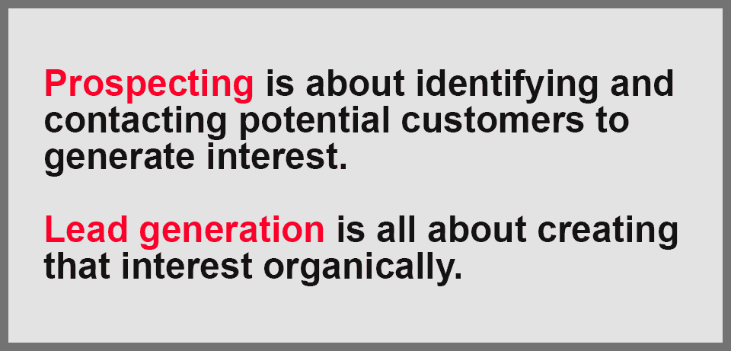

Slide 3
WHO IS A PROSPECT
A PERSON WITH A NEED OR REASON
HAVING AN AUTHORITY TO TAKE DECISION

Slide 4
PROSPECTING
IT IS A PROCESS OF LISTENING WITH PATIENCE AND UNDERSTAND WHAT THE PROSPECT NEED IN LIFE OR WHAT HE WANT TO DO IN LIFE (INVOLVE)

Slide 5
PROCESS
PROSPECTING IS A PROCESS
STUDY YOUR PROSPECT
BUILD RELATIONSHIP
LISTEN WITH HEART
IDENTIFY THE NEED
KEEN LISTENING
OPEN THE MIND
PROVIDE SOLUTION

Slide 6
PROCESS
GREET THE PERSON WITH A SMILE ON YOUR FACE
CREATE A FEEL GOOD FACTOR
MAKE HIM COMFORTABLE
SINCERE APPRECIATION
REMEMBER FIRST IMPRESSION IS THE BEST IMPRESSION
LET THE PROSPECT TALK
CREATE THE NEED
EXPLAIN THE PROJECT ( IF NEEDED)

Slide 7

LAW OF AVERAGE (LEE PERITHO RULE)

Slide 8
OUR RAW MATERIAL IS PROSPECT
BY PROCESSING PROSPECT ONLY YOU CAN SPONSOR
RAW MATERIALS / DATABANK -
TEACHERS
EMPLOYEES
DOCTORS
ENGINEERS
SELF EMPLOYEES
BUSINESS MEN
HOUSEWIVES
STUDENTS ( 18+)
OTHERS

Slide 9
LAW OF AVERAGE – 80 /20 RULE
80 20
MASS | CLASS ( SUITABLE)
SUSPECT | PROSPECT
DOUBTFULL | NEED
CRITICISE | APPRECIATE
NEGATIVE - REGRESS | POSITIVE - PROGRESS
LAZY | ACTIVE
IGNORANT | READY TO LEARN CHANGE
FAILURE | SUCCESS

Slide 10
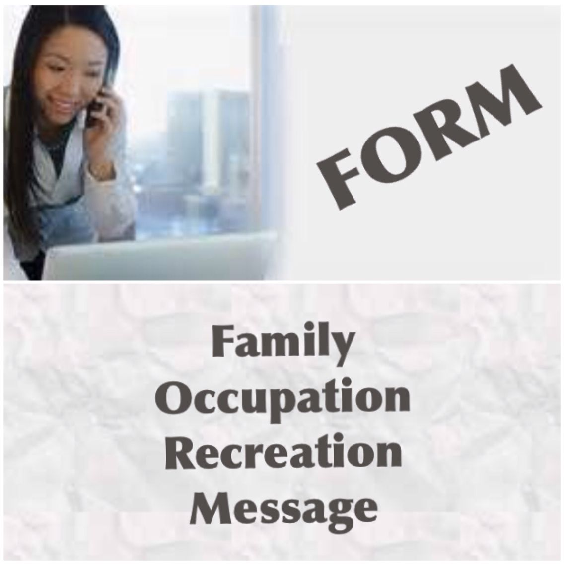

Slide 11

BUILD GOOD RELATIONSHIP
INTERACTION
RAPPORT
COMMON INTEREST
SINCERE APPRECIATION
SHOW INTEREST IN THEIR FUTURE
BE GENUINE
BUILD BELIEF

Slide 12
DO QUALIFYING INTERVIEW
PRIMARY MOTIVATING FACTORS
QUALIFY THEM AS YOUR PROSPECT
CREATE INTEREST IN YOUR PROJECT
SHOW FUTURE IN YOUR PROJECT
PROSPECTING IS AN ART YOU LEARN BY EXPERIENCE AND PRACTICE
EXPLAIN THE POSSIBILITIES

Slide 13
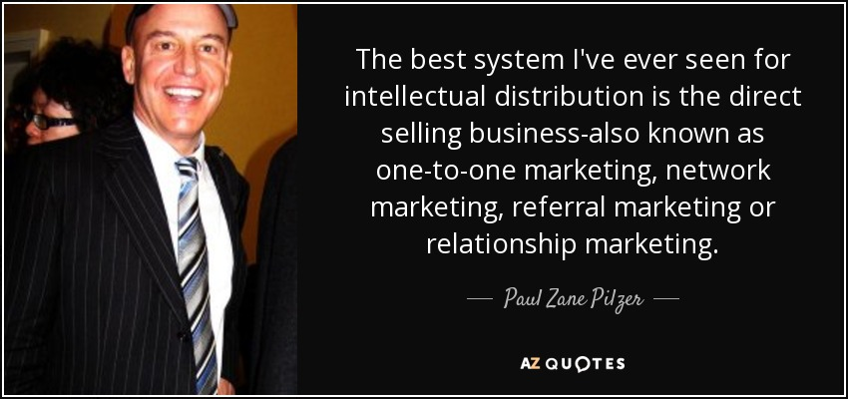
INTELLECTUAL DISTRIBUTION

Slide 14
INTELLECTUAL DISTRIBUTION
EDUCATING A CUSTOMER ABOUT A PRODUCT OR PROJECT WHICH HE NEVER FELT A NEED AND EDUCATING HIM TO PURCHASE BY EXPLAINING THE BENEFIT ( MAKING HIM INVOLVE IN YOUR PROJECT)

Slide 15
APPROACHES FOR PROSPECTING
CURIOSITY APPROACH
FUTURISTIC APPROACH
DIRECT APPROACH
INDIRECT APPROACH
WOMEN EMPOWERMENT APPROACH
YOUTH / CAREER APPROACH

Slide 16
WHAT PROSPECTS LIKE
SINCERE APPRECIATION
GENUINE AND FUTURISTIC THINGS
MORE BENEFITS
FEEL GOOD FACTOR
WHAT IS IN IT FOR THEM

Slide 17
POINTS TO REMEMBER
MEET MORE PEOPLE
PROSPECT 4 -5 PEOPLE EVERYDAY
USE YOUR RAW MATERIAL ( DATA BANK ) PROPERLY
FOLLOW THE PROCESS
QUALIFY PEOPLE AS YOUR PROSPECTS
USE FORM
LOOK FOR THE LOOKERS
TRANSFORM PEOPLE
( PROSPECT – DISTRIBUTOR – DIRECTOR – SILVER - GOLD – STAR – DIAMOND – CROWN –UCD – DCD – DUCD )

Slide 18


Slide 19
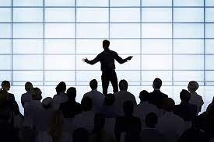
A DISTRIBUTOR/ LEADER MUST -
LEARN THE ART OF PROSPECTING
MAINTAIN DRESSCODE , SELF ESTEEM , ENERGY
MAINTAIN A STEADY CONSTANT POSITIVE MINDSET
PROSPECT 4 – 5 PEOPLE EVERYDAY
ADD EVERDAY 2 -3 NAMES IN YOUR DATABANK
PROCESS PROSPECT AS PER SYSTEM
DO QUALIFYING INTERVIEW EVERYDAY
USE SOCIAL MEDIA

Slide 20
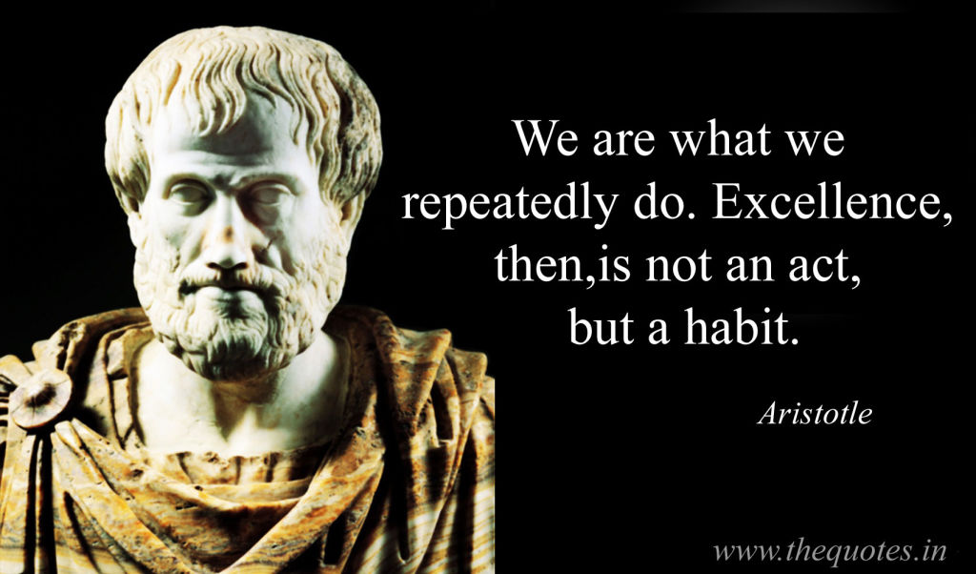

Slide 21


Slide 22

BE A WINNER
BE WITH THE WINNERS
THANK YOU
JYOTHISH KUMAR AND LINI

